Slide 1
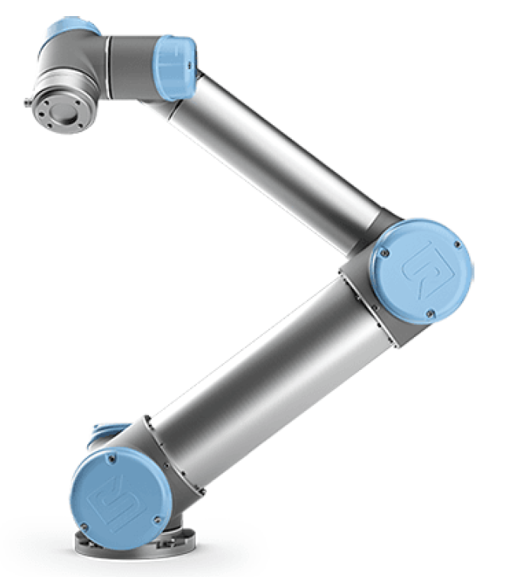
Modeling and simulation of an UR5 Robot Manipulator
Battistini Enrico
Samorì Filippo
Subini Jacopo
AY 2024-2025 Automation Engineering
University of Bologna

Slide 2
Contents
UR5 Robot Manipulator
Denavit - Hartenberg convention
Joint submodel
Link submodel
Harmonic drive submodel
Controller
Gravity compensation
PID tuning
Simulation results
Conclusions

Slide 3
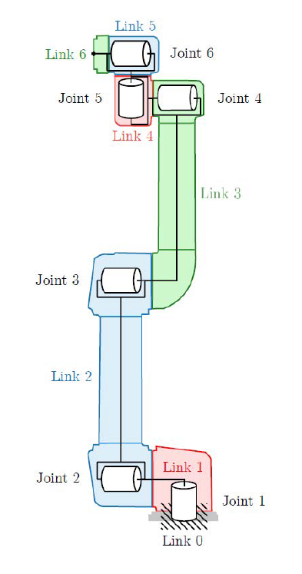
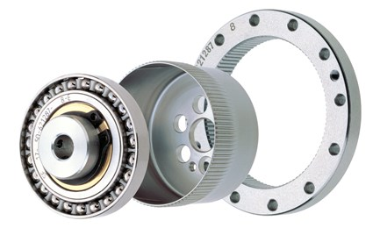
UR5 Robot Manipulator
The UR5 is a robotic arm manipulator with 6-dof.
The hardware parts that have been modelled are:
The HFUS-20 version 2SH for the first three joints
The HFUS-14 version 2SH for the last three joints
The manipulator dynamics, composed of 6 links and 6 joints

Slide 4
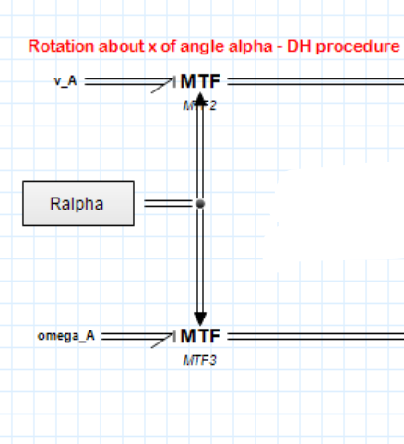
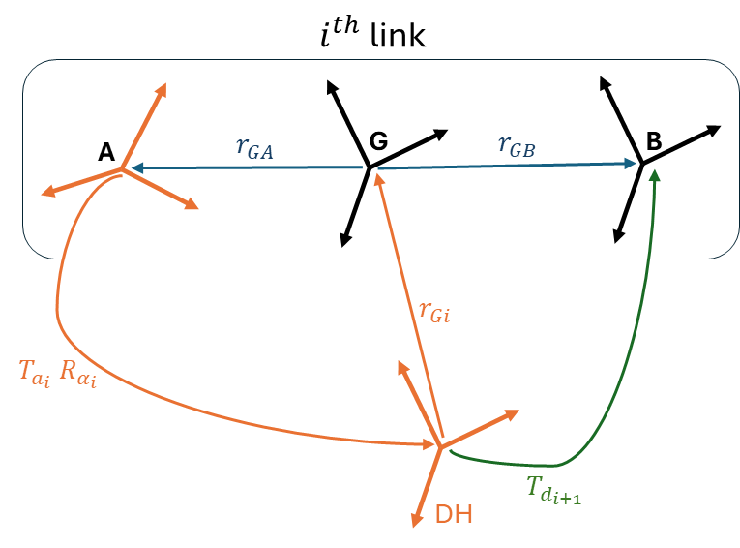
Denavit - Hartenberg
Inside the model, in order to change properly the reference frame when we compute the vectors need to be used, we perform the rotations given by the Denavit-Hartenberg convention using Modulated Transformers blocks. In this way we are always in the correct coordinate frame.
Example of frame rotation

Slide 5
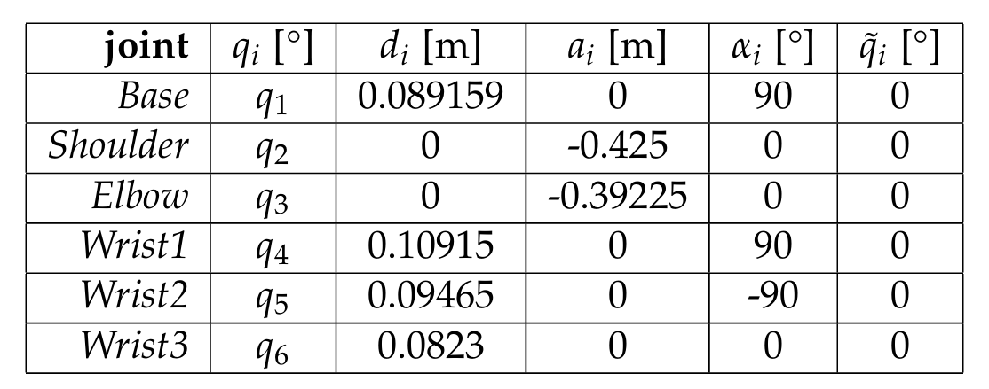
Denavit - Hartenberg
Denavit – Hartenberg Table

Slide 6
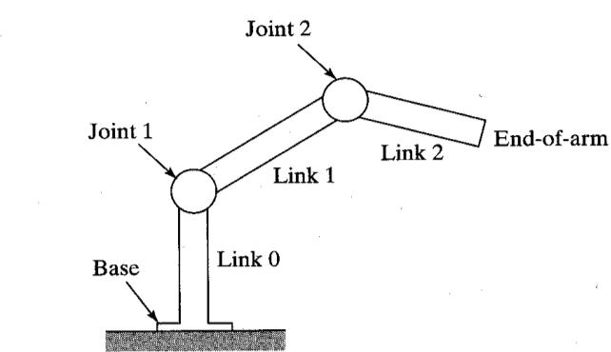
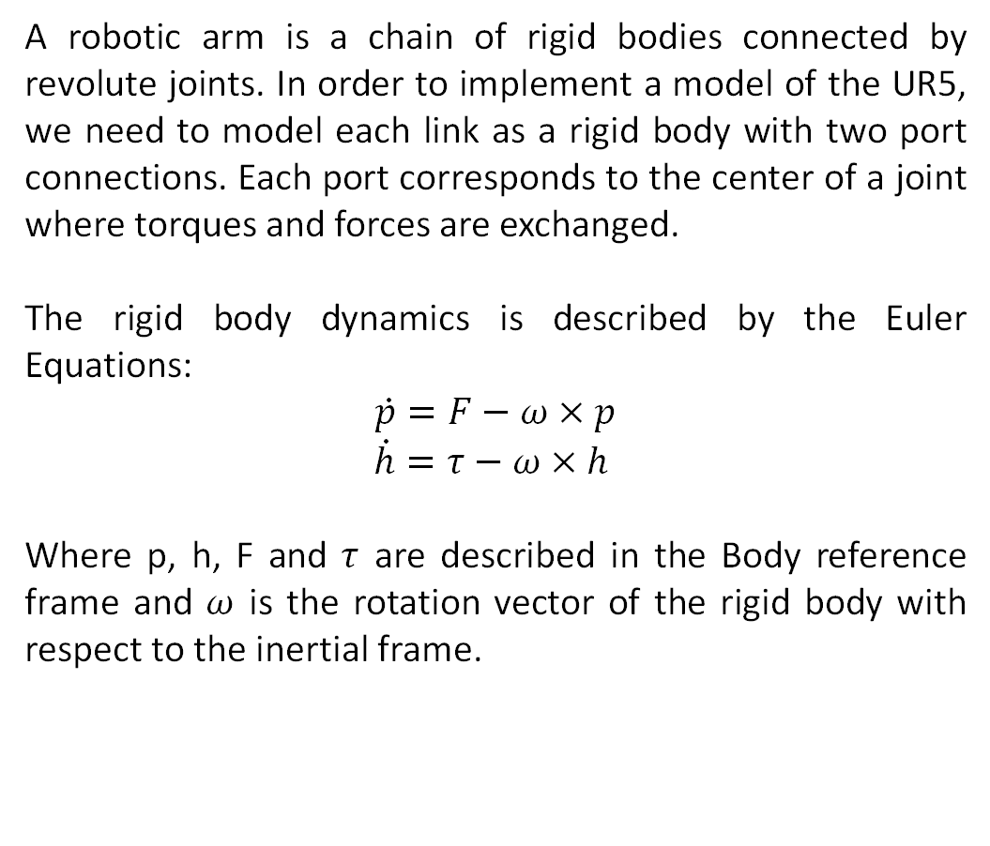
Link Submodel
A robotic arm is a chain of rigid bodies connected by revolute joints. In order to implement a model of the UR5, we need to model each link as a rigid body with two port connections. Each port corresponds to the center of a joint where torques and forces are exchanged.
The rigid body dynamics is described by the Euler Equations:
$$\dot{p}=F−ω×p$$
$$\dot{h}=τ−ω×h$$
Where p, h, F and $τ$ are described in the Body reference frame and $ω$ is the rotation vector of the rigid body with respect to the inertial frame.

Slide 7
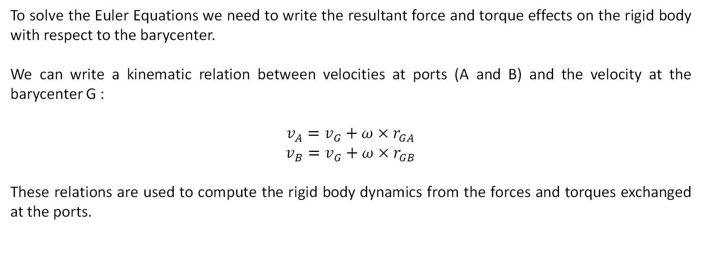
Link Submodel
To solve the Euler Equations we need to write the resultant force and torque effects on the rigid body with respect to the barycenter.
We can write a kinematic relation between velocities at ports (A and B) and the velocity at the barycenter G :
$$v_{A}=v_{G}+ω×r_{GA}$$
$$v_{B}=v_{G}+ω×r_{GB}$$
These relations are used to compute the rigid body dynamics from the forces and torques exchanged at the ports.

Slide 8
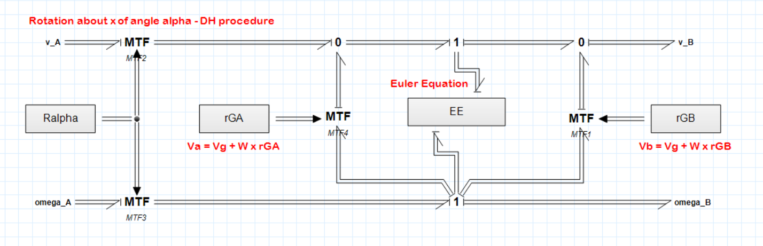
Link Submodel

Slide 9
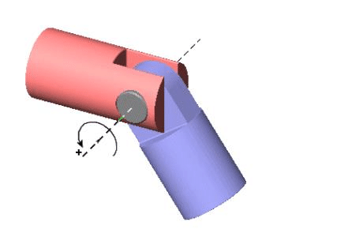
Joint Submodel
The revolute joint is modelled as a constraint on the relative motion between links.
The joint has 1 degree of freedom, the rotation about z, while the other motions are constrained to have a zero relative velocity. The input to the joint is the torque applied to the z axis.
The angle Theta is computed as the integral of the angular velocity.
Then the velocities in the port B of the joint are transformed in a new reference frame rotated about z by the angle Theta, to follow the Denavit Hartenberg convention.

Slide 10
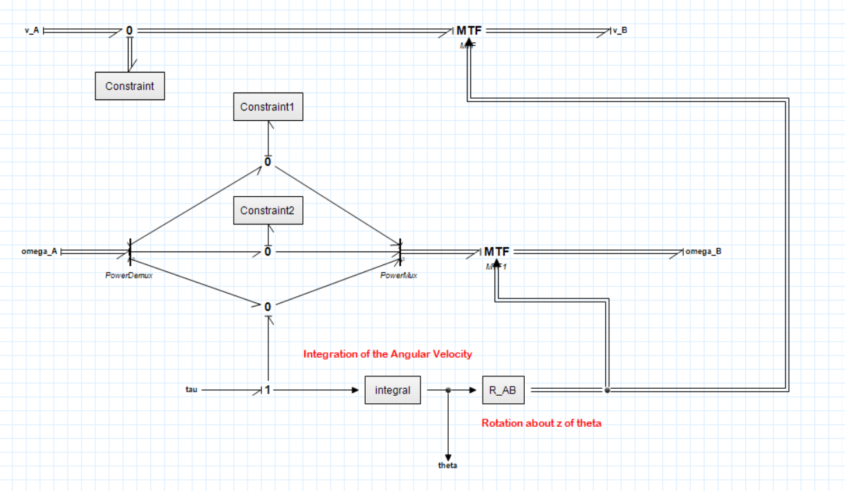
Joint Submodel

Slide 11
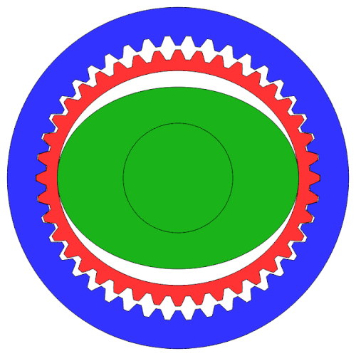
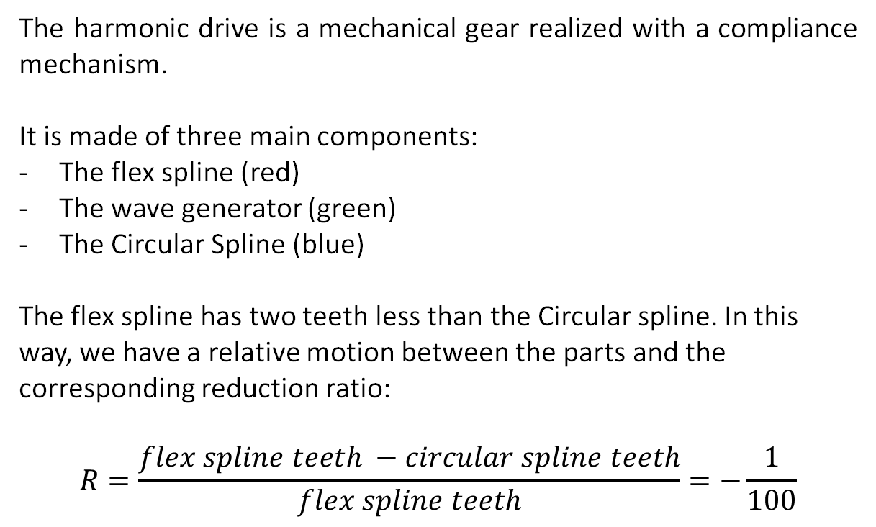
Harmonic drive submodel
The harmonic drive is a mechanical gear realized with a compliance mechanism.
It is made of three main components:
The flex spline (red)
The wave generator (green)
The Circular Spline (blue)
The flex spline has two teeth less than the Circular spline. In this way, we have a relative motion between the parts and the corresponding reduction ratio: $$R=\frac{flex spline teeth −circular spline teeth}{flex spline teeth}=−\frac{1}{100}$$

Slide 12
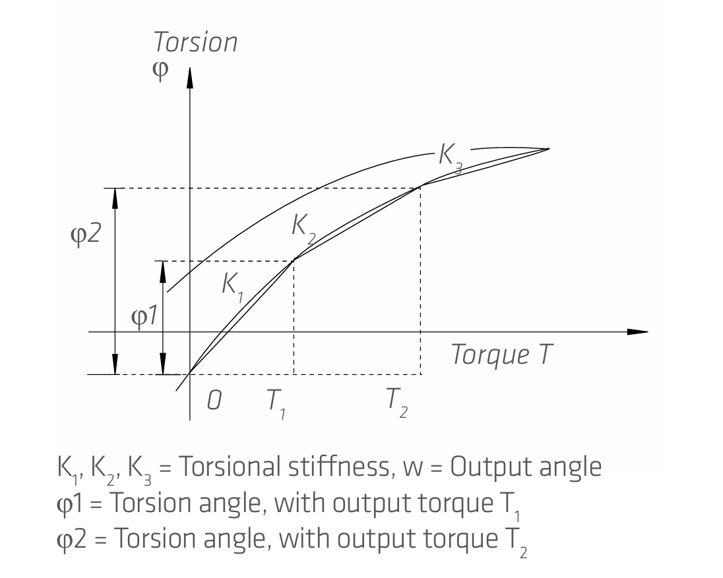
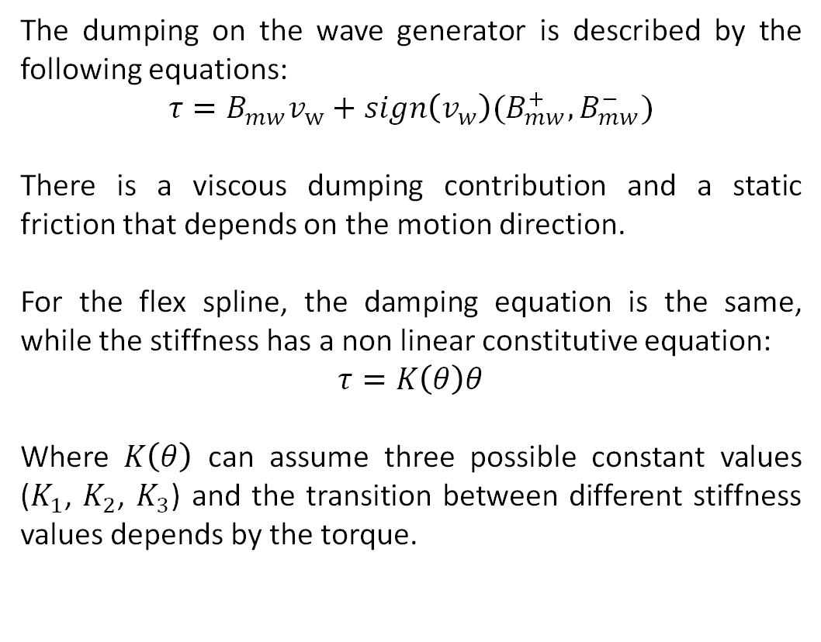
Harmonic drive submodel
The dumping on the wave generator is described by the following equations:
$$τ=B_{mw}v_{w}+sign\left(v_{w}\right)(B_{mw}^{+},B_{mw}^{−})$$
There is a viscous dumping contribution and a static friction that depends on the motion direction.
For the flex spline, the damping equation is the same, while the stiffness has a non linear constitutive equation:
$$τ=K\left(θ\right)θ$$
Where $K\left(θ\right)$ can assume three possible constant values ($K_{1}$, $K_{2}$, $K_{3}$) and the transition between different stiffness values depends by the torque.

Slide 13
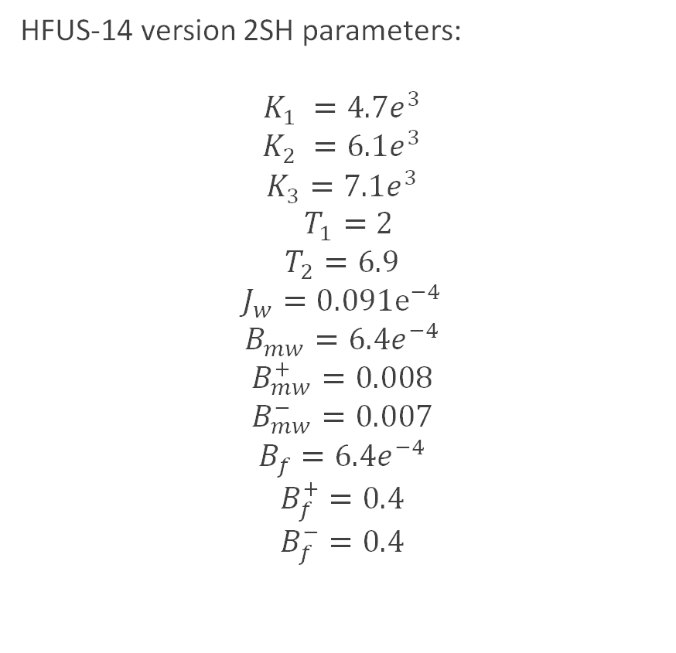

Harmonic drive submodel
HFUS-20 version 2SH parameters:
$$K_{1} =16e^{3}$$
$$K_{2} =25e^{3}$$
$$K_{3}=29e^{3}$$
$$T_{1}=7$$
$$T_{2}=25$$
$$J_{w}=0.404e^{−4}$$
$$B_{mw}=6.4e^{−4}$$
$$B_{mw}^{+}=0.008$$
$$B_{mw}^{−}=0.007$$
$$B_{f}=6.4e^{−4}$$
$$B_{f}^{+}=0.4$$
$$B_{f}^{−}=0.4$$
HFUS-14 version 2SH parameters:
$$K_{1} =4.7e^{3}$$
$$K_{2} =6.1e^{3}$$
$$K_{3}=7.1e^{3}$$
$$T_{1}=2$$
$$T_{2}=6.9$$
$$J_{w}=0.091e^{−4}$$
$$B_{mw}=6.4e^{−4}$$
$$B_{mw}^{+}=0.008$$
$$B_{mw}^{−}=0.007$$
$$B_{f}=6.4e^{−4}$$
$$B_{f}^{+}=0.4$$
$$B_{f}^{−}=0.4$$

Slide 14
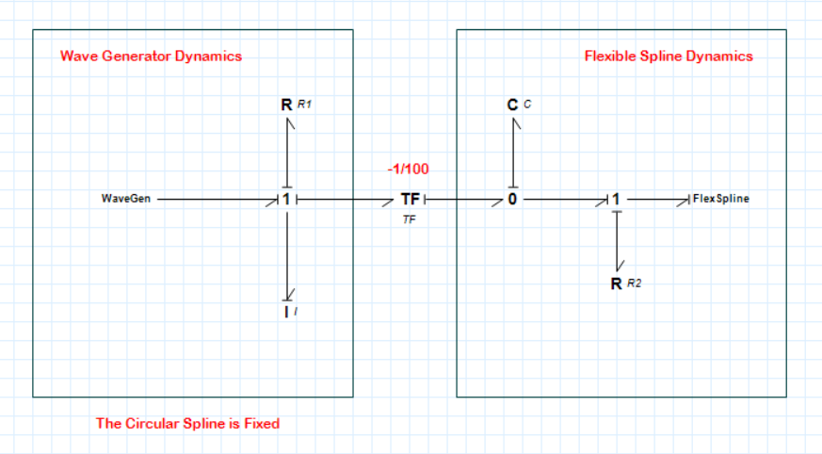
Harmonic drive submodel

Slide 15
Controller
The chosen control policy is a PID + Gravity Compensation controller for the first three joints, and a PI + Gravity Compensation controller for the last three joints of the UR5 manipulator.
Gravity is compensated by a feedforward term, while the PID/PI controllers act as decentralized joint controllers.
PID + Gravity Compensation (first three joints):
a PID controller ensures that even in the presence of modeling inaccuracies or constant biases, the integral action will drive the steady-state error to zero. This provides stronger guarantees of tracking accuracy.
PI + Gravity Compensation (last three joints):
since these joints typically carry lighter loads and experience less dynamic coupling, the derivative term is omitted. The PI controller is sufficient to guarantee stability and zero steady-state error, thanks to the integral action. Moreover, avoiding the derivative term reduces noise sensitivity and makes implementation more practical for joints where fast dynamic response is less crucial.

Slide 16
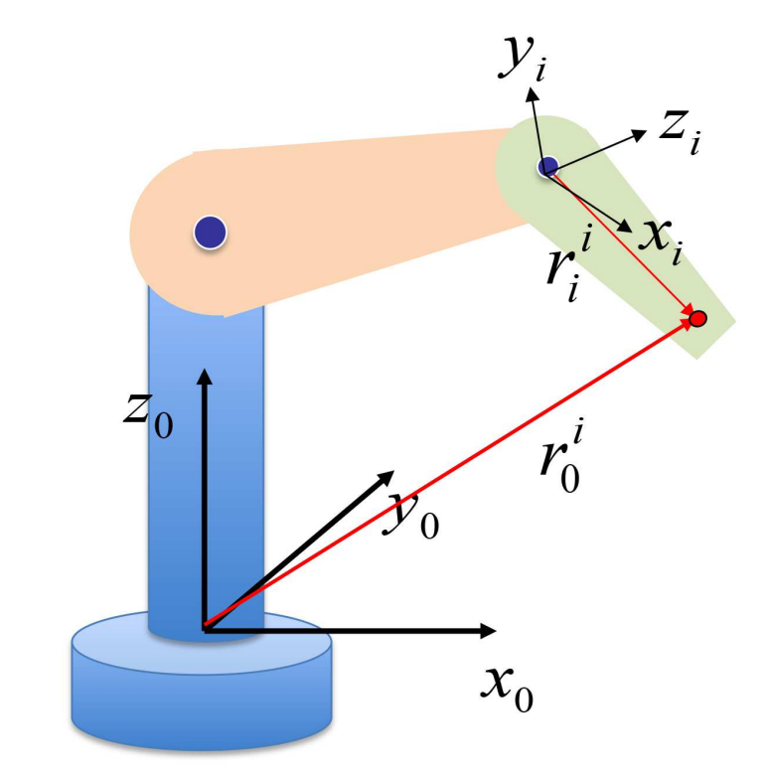
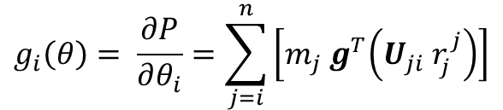
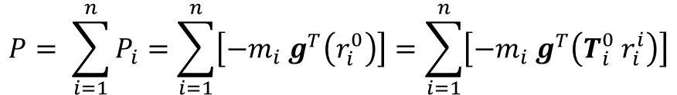
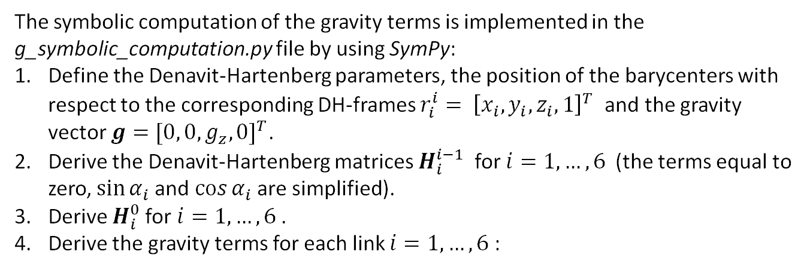
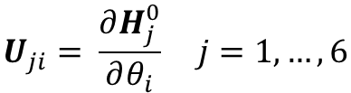
Gravity compensation
$$P= \sum_{i=1}^{n}{P_{i}=\sum_{i=1}^{n}{\left[−m_{i} g^{T}\left(r_{i}^{0}\right)\right]}=\sum_{i=1}^{n}{\left[−m_{i} g^{T}\left(T_{i}^{0} r_{i}^{i}\right)\right]}}$$
Potential energy of the robot arm:
The symbolic computation of the gravity terms is implemented in the g_symbolic_computation.py file by using SymPy:
Define the Denavit-Hartenberg parameters, the position of the barycenters with respect to the corresponding DH-frames $r_{i}^{i}= {\left[x_{i},y_{i},z_{i}, 1\right]}^{T}$ and the gravity vector $g=[{0, 0, g_{z}, 0]}^{T}$.
Derive the Denavit-Hartenberg matrices $H_{i}^{i−1}$ for $i=1, …, 6$ (the terms equal to zero,$\sin{α_{i} }$and $\cos{α_{i} }$are simplified).
Derive $H_{i}^{0}$for $i=1, …, 6$ .
Derive the gravity terms for each link $i=1, …, 6$ :
$$g_{i}\left(θ\right)= \frac{∂P}{∂θ_{i}}=\sum_{j=i}^{n}{\left[m_{j} g^{T}\left(U_{ji}{ r}_{j}^{j}\right)\right]}$$
$$U_{ji}= \frac{∂H_{j}^{0}}{∂θ_{i}} j=1, …, 6$$
Effects of motion of joint i on the points of link j:

Slide 17
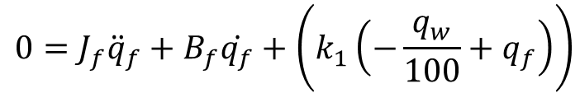
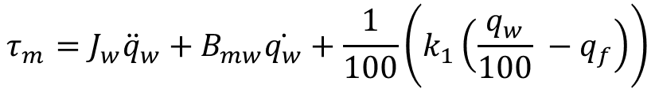
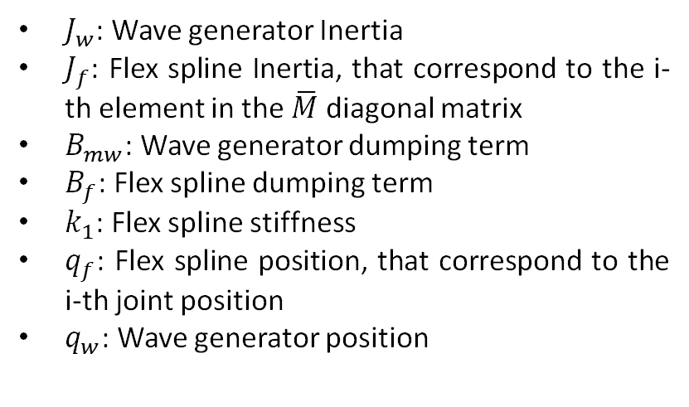
PID tuning
The tuning has been performed considering a simplified linear system, keeping into account a linearization of the Harmonic Drive dynamics and a simplified model for the robotic arm.
The Harmonic Drive has been linearized for small velocities and displacements, neglecting the static friction. The resultant linear dynamic model has four states and is described by the equations below:
$J_{w}$: Wave generator Inertia
$J_{f}$: Flex spline Inertia, that correspond to the i-th element in the $\overline{M}$ diagonal matrix
$B_{mw}$: Wave generator dumping term
$B_{f}$: Flex spline dumping term
$k_{1}$: Flex spline stiffness
$q_{f}$: Flex spline position, that correspond to the i-th joint position
$q_{w}$: Wave generator position
$$τ_{m}=J_{w}{\ddot{q}}_{w}+B_{mw}\dot{q_{w}}+\frac{1}{100}\left(k_{1}\left(\frac{q_{w}}{100} −q_{f}\right)\right)$$
$$0=J_{f}{\ddot{q}}_{f}+B_{f}\dot{q_{f}}+\left(k_{1}\left(−\frac{q_{w}}{100}+q_{f}\right)\right)$$

Slide 18
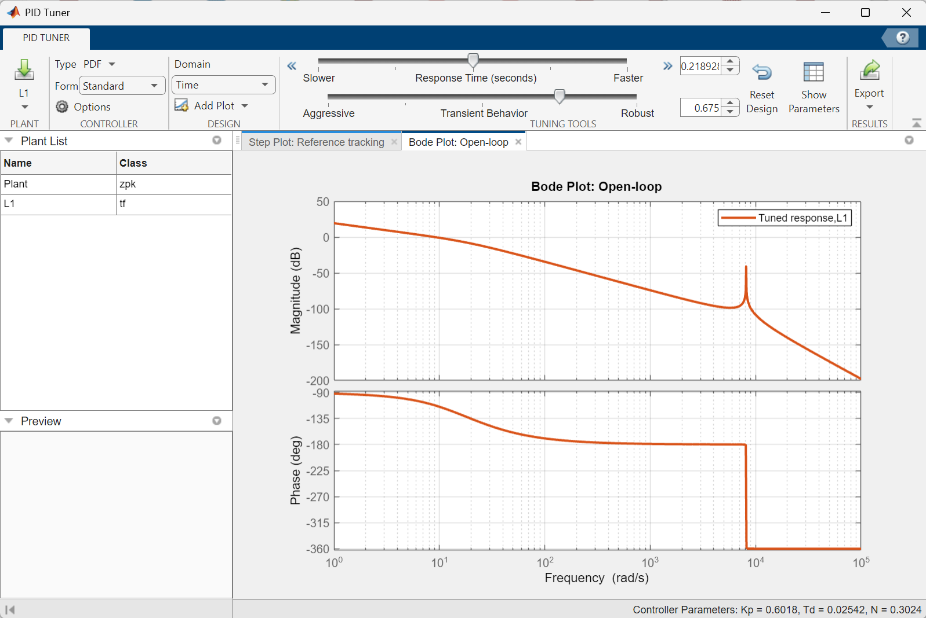
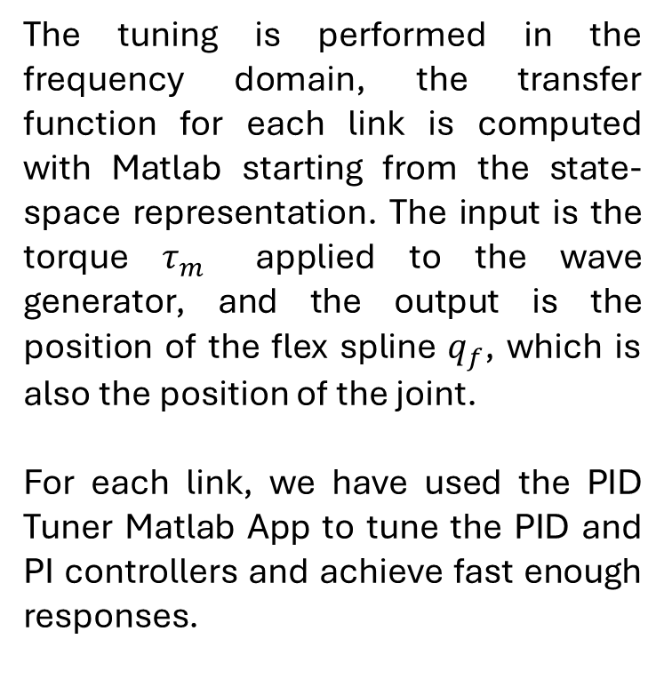
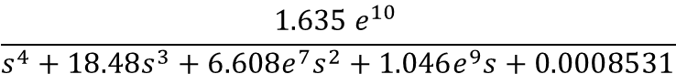
PID tuning
The tuning is performed in the frequency domain, the transfer function for each link is computed with Matlab starting from the state-space representation. The input is the torque $τ_{m}$ applied to the wave generator, and the output is the position of the flex spline $q_{f}$, which is also the position of the joint.
For each link, we have used the PID Tuner Matlab App to tune the PID and PI controllers and achieve fast enough responses.
$$\frac{\text{1.635} e^{10 }}{s^{4}+18.48s^{3}+6.608e^{7}s^{2}+1.046e^{9}s+0.0008531}$$
Example: first joint transfer function and bode diagram

Slide 19
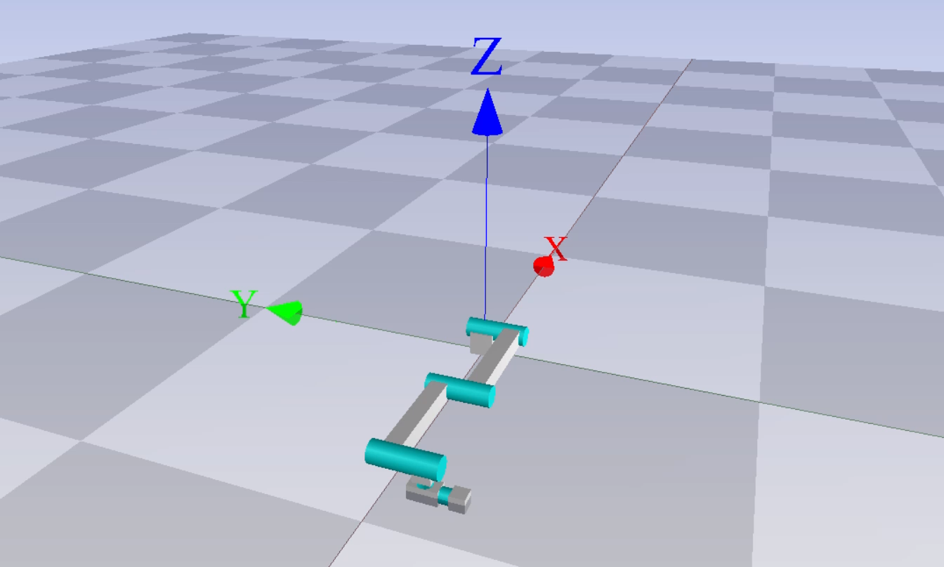
Simulation Results
For simulation purpose, we have desiged a three points trajectory for a pick and place task.
The transition between the points follows cycloidal trajectory and the points are interpolated in the joint space.

Slide 20
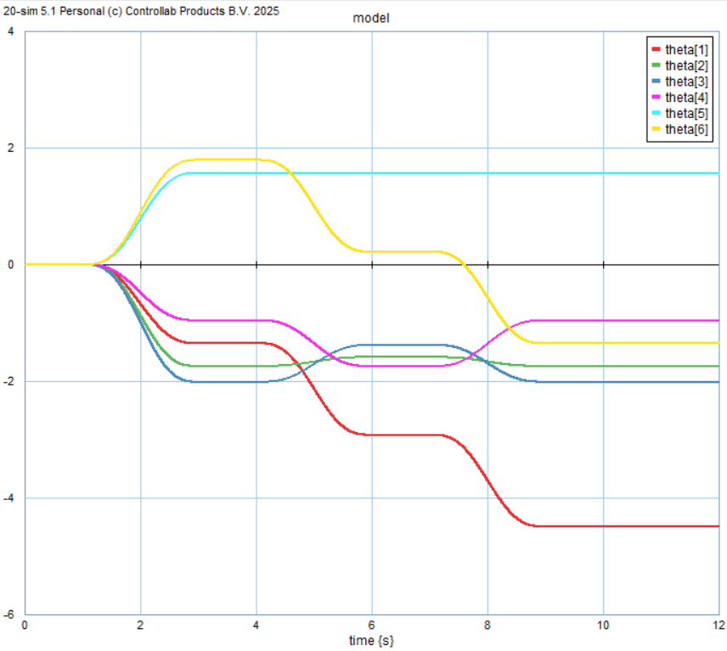
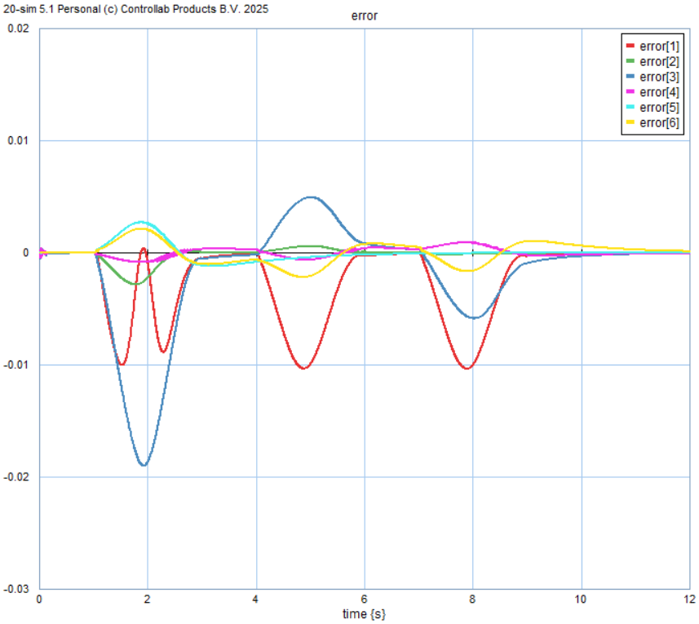
Simulation Results
Joint positions:
Error:

Slide 21
Conclusions
From the simulation results, we can conclude that the robot model behaves consistently with the real physical system. Gravity compensation is accurately achieved, and the use of PID controllers for the first three joints and PI controllers for the last three joints demonstrates performance close to the expected behavior.
For more comprehensive model validation, it would be beneficial to compare these simulation results with experimental data obtained from a real UR5 robot.
Overall, this model provides a reliable and effective approximation for control design and simulation purposes, offering improved steady-state performance and robustness, and laying a solid foundation for further development and testing.

Slide 22
Bibliography
Macchelli, A. (n.d.). Modelling and Simulation of Mechatronic Systems M [Slide]. Department of Electrical, Electronic, and Information Engineering (DEI), University of Bologna. Disponibile su: http://www.unibo.it, Email: alessandro.macchelli@unibo.it
Melchiorri, C. (n.d.). Industrial Robotics [Slide]. Dipartimento di Ingegneria dell’Energia Elettrica e dell’Informazione (DEI), Università di Bologna. Disponibile su: http://www.unibo.it, Email: claudio.melchiorri@unibo.it

